Slide 1
 | Upper left-hand corner | Upper right-hand corner | Lower left-hand corner | Lower right-hand corner | Center of poster
18 points | Section contains: 1) Picture of President’s home state’s flag with state’s name (where they lived when they were elected). 2) Occupation before becoming President. 3) What they did after leaving office (if they left alive). Otherwise write that they died in office. 2 and 3 should be complete sentences. | Section contains: 1) Picture of their Vice-President with name underneath (if they had more than one, use the last one). 2) Which state Vice-President was from when elected (or appointed). 3) What Vice-President did after leaving office if they did not die in office. 2 and 3 should be complete sentences. | Section contains: Under heading, “Reasons why he could be considered a good president:” 1) List one reason. 2) List another. 3) List another. 1, 2, and 3 should be complete sentences. These should be fact-based and not purely opinions. | Section contains: Under heading, “Reasons why he could be considered a bad president:” 1) List one reason. 2) List another. 3) List another. 1, 2, and 3 should be complete sentences. These should be fact-based and not purely opinions. | Section contains: 1) Picture of president with name underneath. 2) Political Party 3) Years in office. No complete sentences necessary.
12 points | Is missing one of these requirements. | Is missing one of these requirements. | Is missing one of these requirements. | Is missing one of these requirements. | Is missing one of these requirements.
6 points | Is missing two of these requirements. | Is missing two of these requirements. | Is missing two of these requirements. | Is missing two of these requirements. | Is missing two of these requirements.
0 points | Is missing all of these requirements. | Is missing all of these requirements. | Is missing all of these requirements. | Is missing all of these requirements. | Is missing all of these requirements.
The entire project is worth 100 points. The final ten points come from presenting to the class.

Slide 2
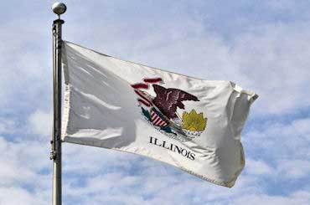
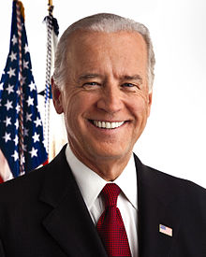
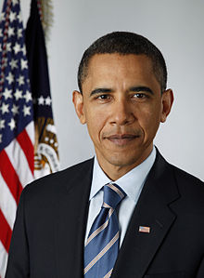
Blank sections can be used for decorations. No glitter. You do not necessarily have to decorate these areas.
Illinois
Before becoming president, he was a United States Senator.
He has yet to leave office.
Joe Biden
Vice President Biden is (you will write “was”) from Delaware.
He has yet to leave office.
Reasons why he could be considered a good president:
President Obama ordered the raid that resulted in the death of Bin Laden.
President Obama saved or created nearly 2 million jobs with 2009 stimulus bill.
President Obama ended US military involvement in Iraq.
Reasons why he could be considered a bad president:
President Obama failed to close Guantanamo Bay despite campaign promises.
President Obama failed to lower unemployment rate to a natural level during first term.
President Obama failed to get Chicago the 2016 Olympics.
Barack Obama
Democrat
2009-2017

